Slide 1

Detecting Abusive Comments in Multiple Languages: A Multilingual Approach
Sai Krishna Sangeetha
Venkata Sai Kumar Ganesula
Group 31

Slide 2
Agenda
Introduction
Problem Statement
Related Work
Hypothesis
Dataset & Data Analysis
Technique
Evaluation
Inference
Hypothesis Testing
Discussion
References

Slide 3
Introduction
India is a diverse country with a rich linguistic heritage. There were 122 major languages and 1599 other languages officially spoken in India, according to 2011 Census of India.
Social media is heavily used by people in a world where internet access is expanding. As a result, there is more offensive, abusive, and hateful content on social media. For applications like controversial event extraction, creating AI chatterbots, content recommendation, and sentiment analysis, hate speech detection on Twitter or any Social Media apps like Facebook, TikTok is essential.
The ability to categorize a tweet or comment as racist, sexist, or neither is how we define this task. This task is very difficult because natural language constructs are so complex.
Our project aims to utilize natural language processing techniques to identify negative comments posted on social media platforms. Once we have identified these negative comments, we can focus on promoting positive content on these platforms. This approach will help us create a more positive and constructive online community.

Slide 4
Problem Statement
The main objective of this project is to propose a model that can determine whether a comment is abusive.
The dataset is made up of comments written in different Indian dialects.
For the best accuracy on the dataset, we want to investigate and contrast various machine learning and deep learning techniques in this project.

Slide 5
Related Work
Simran Khanuja, Diksha Bansal, Sarvesh Mehtani, Savya Khosla, Atreyee Dey, Balaji Gopalan, Dilip Kumar Margam, Pooja Aggarwal, Rajiv Teja Nagipogu, Shachi Dave, Shruti Gupta, Subhash Chandra Bose Gali, Vish Subramanian, Partha Talukdar et al. “MuRIL: Multilingual Representations for Indian Languages”
Summary- A deep learning approach to develop multilingual language models for 17 Indian languages. The authors use a transformer-based architecture and train the model on a large corpus of text in these languages. The model, called MuRIL, outperforms other language models on most benchmark tasks and achieves state-of-the-art performance on several tasks. The paper presents an important contribution to the field of natural language processing by developing a language model that can handle the diverse linguistic properties of Indian languages and improve the performance of natural language processing tasks in these languages.
Pinkesh Badjatiya, Shashank Gupta, Manish Gupta, Vasudeva Varma et al. “Deep Learning for Hate Speech Detection in Tweets”
Summary- The research paper proposes a deep learning approach to detect hate speech in tweets. The authors use a convolutional neural network and a long short-term memory network to classify the tweets. The results show that the deep learning approach outperforms traditional machine learning methods and can be used to build automated systems for hate speech detection and prevention. The authors suggest future work should focus on addressing challenges in detecting hate speech such as sarcasm and context to improve the performance of the model.

Slide 6
Dataset & Data Analysis
The dataset for this task is curated for an ongoing challenge hosted by IEEE BigMM.
The dataset consists of Abusive and Non-abusive comments which were posted on Moj (one of India’s largest short-video apps) in around 13 languages accompanied by contextual user data. (https://www.kaggle.com/c/iiitd-abuse-detection-challenge/data).
Notes:
IEEE International Conference on Multi Media Big Data

Slide 7
Dataset & Data Analysis
Train and Test Data:
Non-abusive : 352,386 ; Abusive : 312,656
Features :
language : Language of the post on which this comment was made. Use this as a weak indicator of the language
post_index : Unique post identifier having this comment
commentText: Comment as a string
report_count_comment : Number of times this comment has been reported
report_count_post : Total number of reports on all comments of this post
like_count_comment : Number of likes on the comment
like_count_post : Total number of likes on all comments of this post
label : Label to predict. 0-Non-abusive, 1-Abusive

Slide 8
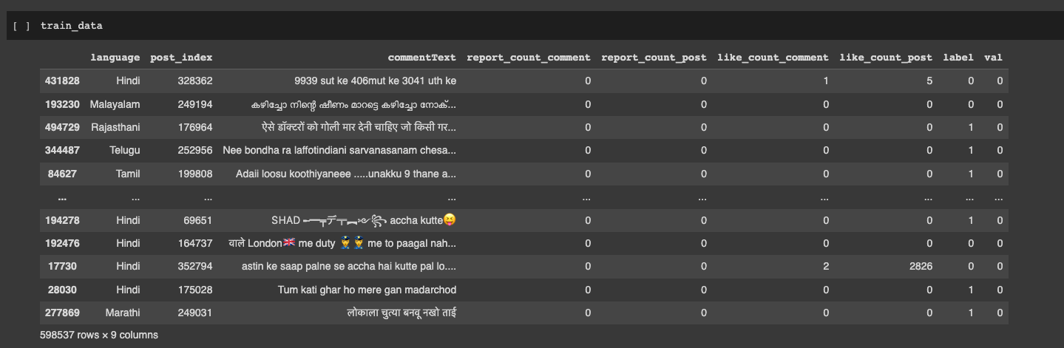
Dataset & Data Analysis

Slide 9
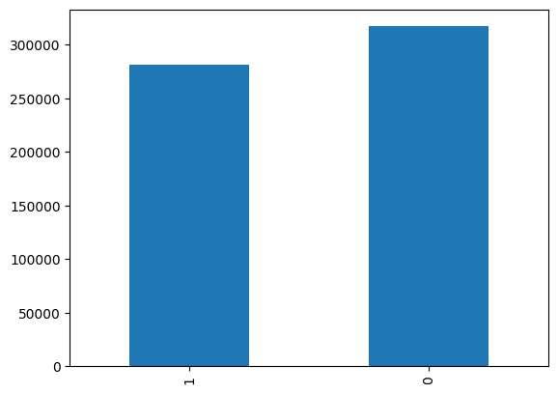
Data Distribution by Class
Class Distribution
0 : Non-Abusive
1 : Abusive
0 317181
1 281356

Slide 10
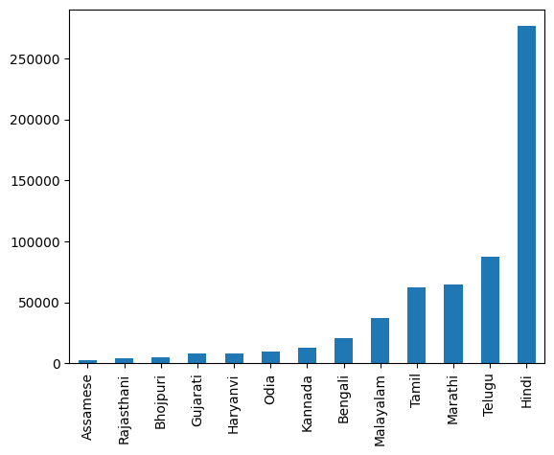
Data Distribution by Language
Hindi 276331
Telugu 87343
Marathi 64932
Tamil 62542
Malayalam 36784
Bengali 20568
Kannada 12584
Odia 9857
Haryanvi 7981
Gujarati 7933
Bhojpuri 5215
Rajasthani 3917
Assamese 2550

Slide 11
Challenges
Today’s state-of-the-art multilingual systems perform sub-optimally on Indian (IN) languages.
Large set of morphological variants.

Slide 12
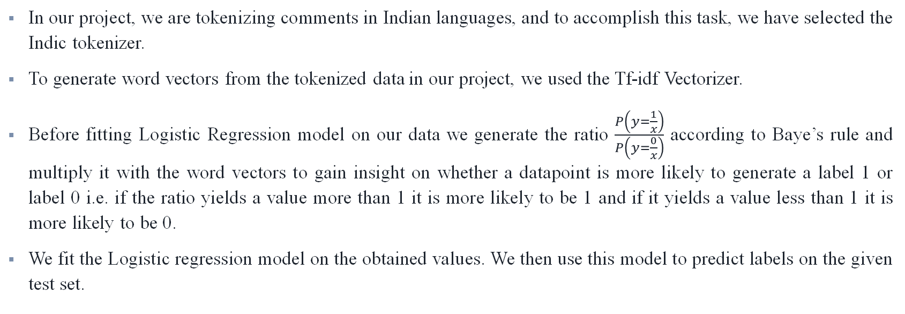
Model 1
Using Indic tokenizer to tokenize the data
TF-idf Vectorizer to get word vectors
Calculating probability using Naïve Baye’s
Fit the Logistic Regression & predict labels
In our project, we are tokenizing comments in Indian languages, and to accomplish this task, we have selected the Indic tokenizer.
To generate word vectors from the tokenized data in our project, we used the Tf-idf Vectorizer.
Before fitting Logistic Regression model on our data we generate the ratio $\frac{P\left(y=\frac{1}{x}\right)}{P\left(y=\frac{0}{x}\right)}$ according to Baye’s rule and multiply it with the word vectors to gain insight on whether a datapoint is more likely to generate a label 1 or label 0 i.e. if the ratio yields a value more than 1 it is more likely to be 1 and if it yields a value less than 1 it is more likely to be 0.
We fit the Logistic regression model on the obtained values. We then use this model to predict labels on the given test set.
Notes:
Indic Tokenizer- The reason for this choice is that traditional tokenizers available in Python libraries such as spaCy and NLTK may not be well-suited to handle Indian languages. The Indic NLP library, which was specifically designed for Indian languages, provides us with a solution to this problem. Since, Indic tokenizer tokenizes based on the punctuation boundaries.
We opted for this approach because pre-trained embeddings like gloVe embeddings and word2vec are designed primarily for English text and may not be effective for Indian languages. The Tf-idf Vectorizer was selected because it calculates the significance of each word in a document based on its frequency within that document, compared to its frequency in the corpus. This method enables us to assess the originality of each word and generate appropriate word vectors.

Slide 13
Model 2a
Tokenize the data
Generate Embeddings
Passing embeddings through a fully connected NN to predict the labels
Usage of word embeddings is a proven technique for achieving a good accuracy in classification tasks. In this approach, we have trained embeddings layer on the training dataset for prediction on testing dataset.
We removed punctuation and tokenized the data.
For generation of embeddings, vocabulary was built on training set. The embedding layer expects an uniform size as an input and hence the data was prepared accordingly.
The embeddings are then passed through a fully connected neural network for prediction.
The model was trained using RMSprop optimizer and varying number of epochs for achieving best accuracy on the test set.
Hyperparameters - vocabulary size = 10000, number of epochs = [10,20], Feature dimension = 8, Max length = 128 and batch size = 512.

Slide 14
Model 2b
Extension to Model 2a
Altering the output dimension to 100 to mimic output of Glove
Passing embeddings through a fully connected NN to predict the labels
This model is an extension to Model 2a.
GloVe embeddings is a popular pre-trained embeddings used for NLP tasks in English language but as we are dealing with Indian languages we cannot use pretrained GloVe embeddings.
We have changed the output dimension of embeddings layer from 8 to 100 to mimic the output of GloVe which is a 100 dimension feature.
As we have increased the feature dimension, there was an increase in the accuracy. This is achieved as the model was able to learn better with larger feature dimension.
Hyperparameters - vocabulary size = 10000, number of epochs = [10,20,3], Feature dimension = 100, Max length = 128 and batch size = 512.

Slide 15
Model 2c
Extension to Model 2a
Adding advanced deep learning techniques like Bidirectional LSTM and Batch Normalization
Passing embeddings through a fully connected NN to predict the labels
This model is an extension to Model 2a. We have added more advanced deep learning techniques like Bidirectional LSTM and Batch normalization.
LSTM is a sequence based model which performs well on textual data in classification tasks.
The model configuration and fine-tuning is performed similar to that of Model 2a.
Because of making the model more complex, the model was able to achieve a higher accuracy than that of Model 2a and a similar accuracy to that of Model 2b.
Hyperparameters - vocabulary size = 10000, number of epochs = [10,20], Feature dimension = 8, Max length = 128 and batch size = 512.

Slide 16
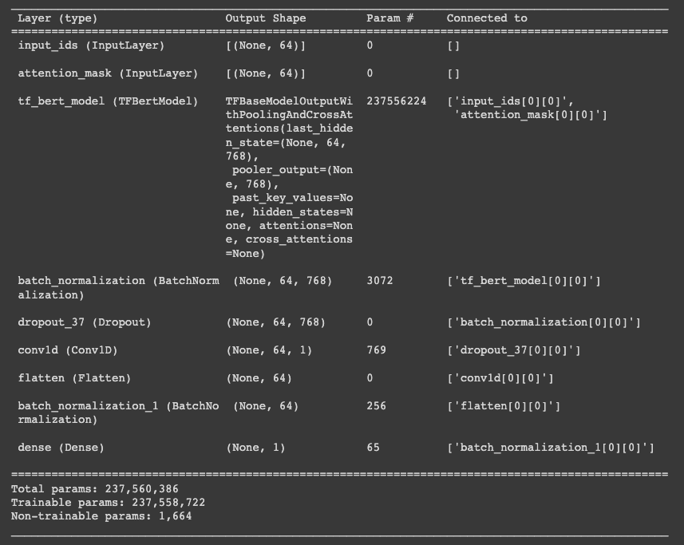
Proposed Model
MuRIL: Multilingual Representations for Indian Languages
We have used MuRIL to generate word embeddings for the comments data. Before using MuRIL we need to tokenize the data into a certain format which is achieved by using AutoTokenizer. We chose MURIL because it is a BERT model pretrained on huge data from Indian languages and would generate very meaningful embeddings for our case.
We used a fully connected Neural Network for prediction of labels based on generated embeddings.

Slide 17
Architecture
Conv1d
MuRIL Tokenizer
Input ID's
Flatten
MuRIL
Attention Mask's
Batch Normalization
Dense
MuRIL to generate word embeddings
Prediction of labels based on generated embeddings
Preprocessing for MuRIL

Slide 18
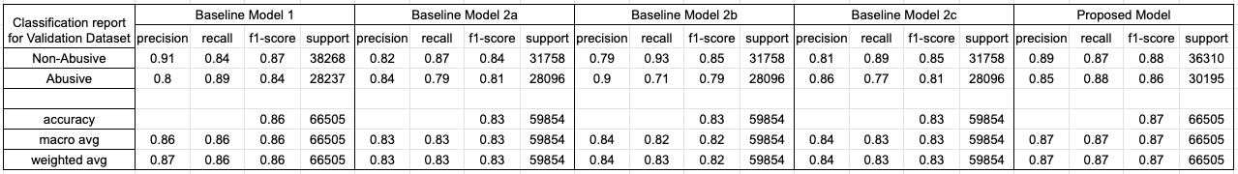
Comparing the Proposed Model with Baseline Models

Slide 19
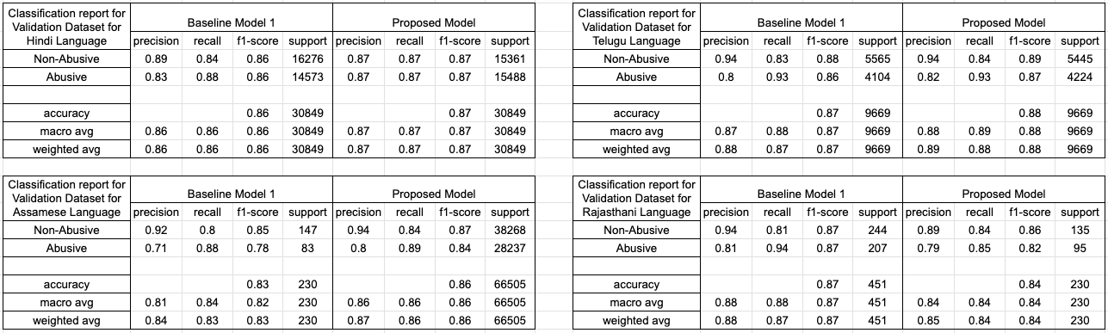
Comparing the Proposed Model with Baseline Models

Slide 20
Hypothesis
Training Model on any two languages (say Hindi and Tamil)
Predicting on dataset pertaining to other languages like Telugu or Bengali
Will the proposed model have capability to be trained on a subset of languages and can be utilized for identifying whether a comment is abusive or non-abusive in other languages?
Training Model on all the available languages
Predicting on the dataset pertaining to one selected language(say Malayalam)
Training Model only data points from selected language(say Malayalam)
Predicting on the dataset pertaining to the selected language(Malayalam)

Slide 21
Hypothesis 1
The model can be trained on a small number of languages and used to determine whether a comment is abusive or not in languages other than English. The model could, for instance, be trained using data from the Hindi and Tamil training sets while making predictions using data from the Telugu or Bengali training sets.
Reasoning: The embeddings for many languages will have the same dimensions because we intend to employ pre-trained models. As a result, the model trained on a dataset for one language can be used to infer on a dataset for another language because the model's parameters are based on the feature vector of the input data point.

Slide 22
Hypothesis 2
Training on all the languages available in the dataset will give better performance than training the model for single language.
Reasoning: As the data for a single language is limited, and the model might not generalize well for lesser amount of data; We believe that model will perform better when exposed to higher amount of data and even though the additional data is from a different language.

Slide 23
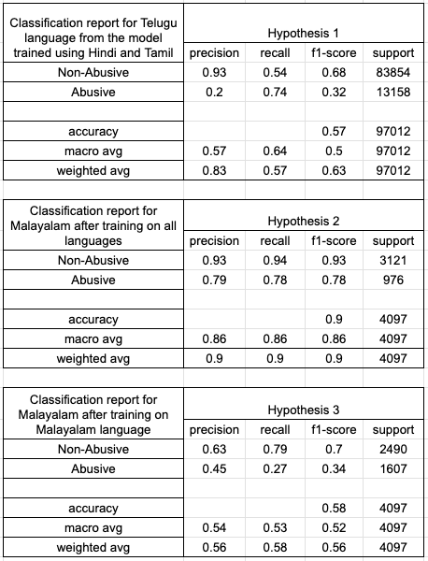
Hypothesis Testing & Results
Inference 1: To evaluate the hypothesis 1, we have trained the MURIL based model with training dataset pertaining to Hindi and Tamil language. The trained model was then evaluated on dataset with Telugu language. We were able to perform prediction on dataset pertaining to Telugu.
Inference 2: To evaluate the hypothesis 2, we have trained the MURIL based model with the complete training dataset and a validation set with data points from Malayalam language. The trained model was then evaluated on the validation set.
Inference 3: Another model was trained with only data points from Malayalam language. This trained model was then evaluated on the validation set.

Slide 24
Conclusion
From the above results we can see that the proposed model gives similar results to the baseline models and better accuracy and outperforms the traditional ML and Deep Learning models.
From the evaluations, we can say that although training of first model was performed not only on a particular language but also from other languages in the dataset, the model was able to learn better than that of the model which was trained only on that particular language. This states that the embeddings from different languages contributes to the model and the trained model can then be inferenced for any language. This is quite useful if we are not able to have enough amount of data for a particular language but abundant of data is available from other languages.

Slide 25
Thank You!!

